Slide 1
Child Mind Institute - Problematic Internet Use
By-: Group 12

Slide 2
Child Mind Institute - Problematic Internet Use
The Healthy Brain Network (HBN) dataset is a clinical sample of about five-thousand 5-22 year-olds who have undergone both clinical and research screenings.
The objective of the HBN study is to find biological markers that will improve the diagnosis and treatment of mental health and learning disorders from an objective biological perspective.
Two elements of this study are being used for this competition:
Physical activity data (wrist-worn accelerometer data, fitness assessments and questionnaires)
Internet usage behavior data.
Actigraphy Files and Field Descriptions
Actigraphy - Objective measure of ecological physical activity through a research-grade bio tracker.
During their participation in the HBN study, some participants were given an accelerometer to wear for up to 30 days continually while at home and going about their regular daily lives.

Slide 3
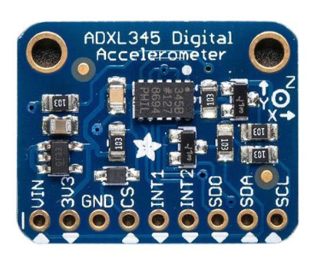
Child Mind Institute - Problematic Internet Use - Actigraphy Data
What is an accelerometer? Accelerometers are movement sensors that measure physical activity and sedentary behavior. It is a device that allows to measure and analyze linear and angular acceleration. They are commonly used in clinical and epidemiological research, and can be attached to the hip, wrist, or thigh.
Digital Accelerometer

Slide 4
How does Accelerometer works ?
Accelerometer measures the acceleration force in unit (g) and take measurements in one, two or three planes. Currently, the most commonly used accelerometers are 3-axis accelerometers, which are designed as a system of three separate accelerometers, each of whom measures acceleration in a different direction - in X, Y and Z planes.
If the acceleration in any plane works in the opposite direction to that in which the sensor is directed, the accelerometer will measure the acceleration with a negative value. Otherwise, the acceleration will be measured with a positive value.

Slide 5
Child Mind Institute Problematic Internet Use- Actigraphy Data
series_{train|test}.parquet/id={id} - Series to be used as training data, partitioned by id. Each series is a continuous recording of accelerometer data for a single subject spanning many days.
id - The patient identifier corresponding to the id field in train/test.csv.
step - An integer timestep for each observation within a series.
X, Y, Z - Measure of acceleration, in g, experienced by the wrist-worn watch along each standard axis.
enmo - As calculated and described by the wristpy package, ENMO is the Euclidean Norm Minus One of all accelerometer signals (along each of the x-, y-, and z-axis, measured in g-force) with negative values rounded to zero. Zero values are indicative of periods of no motion. While no standard measure of acceleration exists in this space, this is one of the several commonly computed features.
anglez - As calculated and described by the wristpy package, Angle-Z is a metric derived from individual accelerometer components and refers to the angle of the arm relative to the horizontal plane.
non-wear_flag - A flag (0: watch is being worn, 1: the watch is not worn) to help determine periods when the watch has been removed, based on the GGIR definition, which uses the standard deviation and range of the accelerometer data.
light - Measure of ambient light in lux. See ​​here for details.
battery_voltage - A measure of the battery voltage in mV.
time_of_day - Time of day representing the start of a 5s window that the data has been sampled over, with format %H:%M:%S.%9f.
weekday - The day of the week, coded as an integer with 1 being Monday and 7 being Sunday.
quarter - The quarter of the year, an integer from 1 to 4.
relative_date_PCIAT - The number of days (integer) since the PCIAT test was administered (negative days indicate that the actigraphy data has been collected before the test was administered).

Slide 6
Child Mind Institute - Problematic Internet Use - ENMO
Euclidean Norm Minus One (ENMO) is a metric used to calculate physical activity from accelerometer data:
Summing the squared acceleration of each of the three accelerometer axes at each time point
Subtracting the gravitational component, which is 1 g (1 g = 9.81 m/s2)
Truncating any resulting negative values to zero
Euclidean Norm Minus One (ENMO) is used to generate metrics that describe and is a important feature of the Actigraphy Dataset.
Physical activity volume (average acceleration)
Intensity distribution (intensity gradient)
Intensity of the most active periods (MX metrics) of the day
Zero values are indicative of periods of no motion.
ENMO is a 1-dimensional measure as opposed to the 3-dimensional raw acceleration, and it is less sensitive to changes of the sensors’ axes. Although it cannot resolve all issues with the raw acceleration, the ENMO measurements from different devices are more homogeneous than the raw acceleration data.

Slide 7
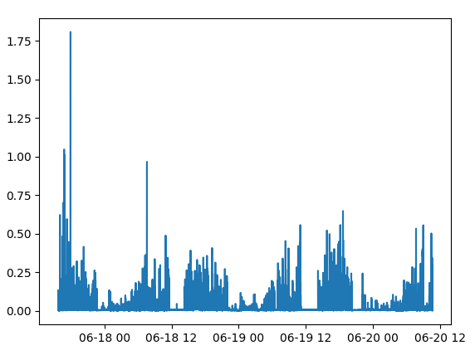
Child Mind Institute - Problematic Internet Use Actigraphy Data
Plot the ENMO across the entire data set:

Slide 8
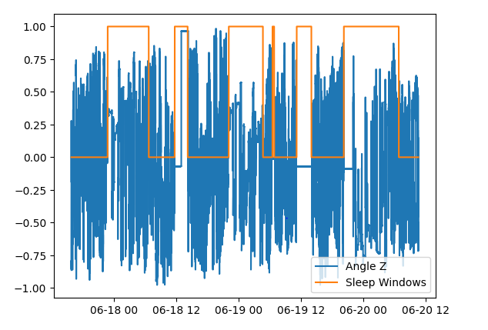
Child Mind Institute Problematic Internet Use - angle-z
The Z-axis of an accelerometer measures the acceleration of gravity when a device is placed face-up on a surface. The Z-axis is one of three axes on an accelerometer that measure acceleration along the X, Y, and Z directions.
Orientation
The orientation of the X, Y, and Z axes relative to the device remains constant.
Gravity
When a device is placed face-up on a surface, the Z-axis measures the acceleration of gravity, which is roughly 9.81 m/s2
Plot the sleep windows with normalized angle-z data

Slide 9
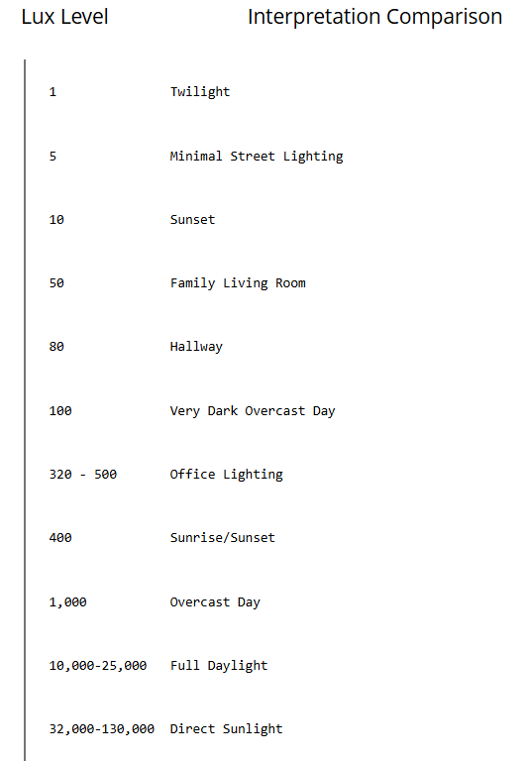
Child Mind Institute Problematic Internet Use - Light
Ambient light may affect subject sleeping habits and thus is a useful tool in analyzing circadian rhythms and sleeping patterns. Lux data is stored once per epoch.
For GT3X+/ActiSleep+/wGT3X+/wActiSleep+ devices, Lux data is stored once per second. When converting a GT3X+ raw file into an accumulated *.agd format with epoch lengths greater than one second, the lux values for that epoch are averaged.

Slide 10
Child Mind Institute Problematic Internet Use
time_of_day - Time of day representing the start of a 5s window that the data has been sampled over, with format %H:%M:%S.%9f.
weekday - The day of the week, coded as an integer with 1 being Monday and 7 being Sunday.
quarter - The quarter of the year, an integer from 1 to 4.

